Slide 1
Chapter 3 LINEAR MODELS FOR REGRESSION
Supervised learning: $N$ observations $\{x_{n}\}$with corresponding target values $\{t_{n}\}$are provided. The goal is to predict the continuous target $t$ of a new value $x$.
The simplest approach: construct a function such that $y(x)$is a prediction of $t$.
Probabilistic perspective: model the predictive distribution $p(t|x).$
3.1. Linear Basis Function Models
3.2. The Basis-Variance Decomposition
3.3. Bayesian Linear Regression
3.4. Bayesian Model Comparison
3.5. The Evidence Approximation
3.6. Limitations of Fixed Basis Functions
Notes:
linear combinations of a fixed set of nonlinear functions of the input variables.
Such models are linear functions of the parameters, which gives them simple analytical properties, and yet can be nonlinear with respect to the input variables.

Slide 2
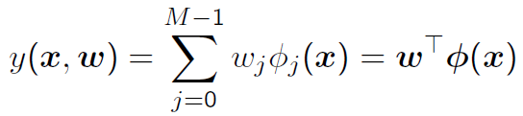







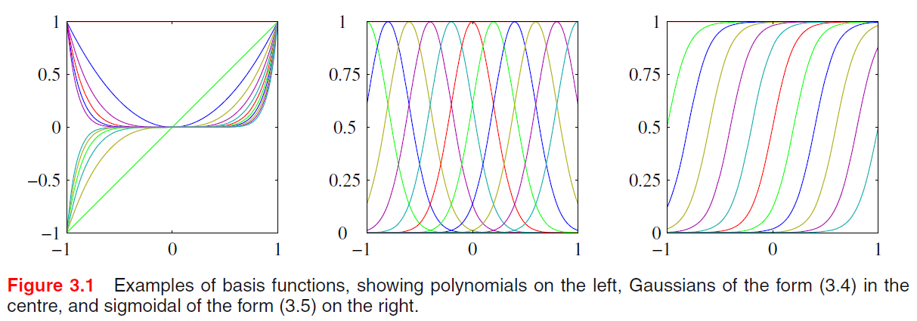
3.1. Linear Basis Function Models
a bias parameter
Basis function choices
Polynomial
Gaussian
Sigmoidal
splines, Fourier, wavelets, etc.
Notes:
linear combinations of a fixed set of nonlinear functions of the input variables.
Such models are linear functions of the parameters, which gives them simple analytical properties, and yet can be nonlinear with respect to the input variables.

Slide 3


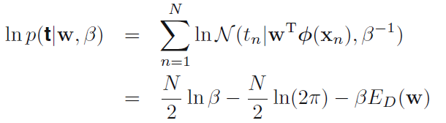

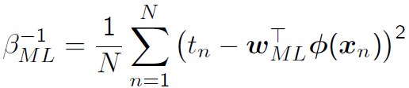
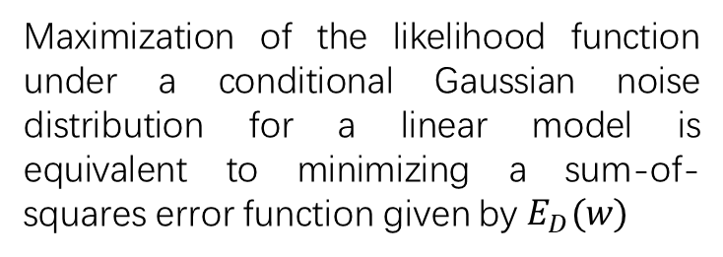
3.1. Linear Basis Function Models
Maximum likelihood and least squares
For a i.i.d. data set we have the likelihood function:
We can use the machinery of MLE to estimate the parameters $w$ and the precision $β$:
logarithm of the likelihood
sum-of-squares error
Maximization of the likelihood function under a conditional Gaussian noise distribution for a linear model is equivalent to minimizing a sum-of-squares error function given by $E_{D}(w)$
Notes:
We also showed that this error function could be motivated as the maximum likelihood solution under an assumed Gaussian noise model.

Slide 4
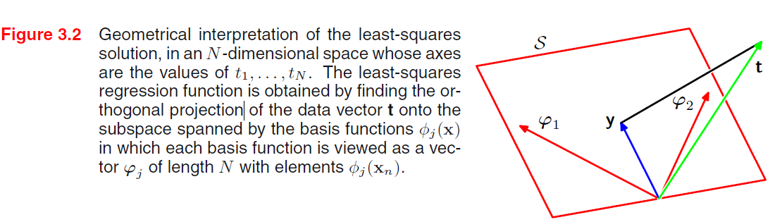
3.1. Linear Basis Function Models
Geometry of least squares
Notes:
The geometrical interpretation of the least-squares solution.

Slide 5

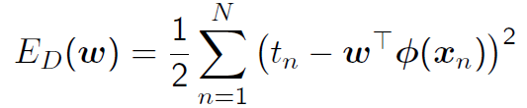

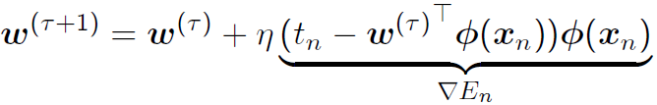

3.1. Linear Basis Function Models
Sequential learning
Apply a technique known as stochastic gradient descent or sequential gradient descent, i.e.,
updates the parameter vector $w$ using
$η$ is a learning rate parameter
Notes:
sequential algorithms, also known as on-line algorithms
least-mean-squares algorithm

Slide 6



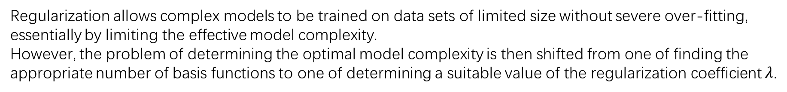
3.1. Linear Basis Function Models
Regularized least squares
Adding a regularization term to an error function in order to control over-fitting
weight decay
parameter shrinkage
Regularization allows complex models to be trained on data sets of limited size without severe over-fitting, essentially by limiting the effective model complexity.
However, the problem of determining the optimal model complexity is then shifted from one of finding the appropriate number of basis functions to one of determining a suitable value of the regularization coefficient $λ$.

Slide 7



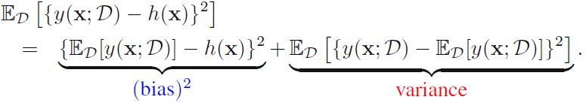
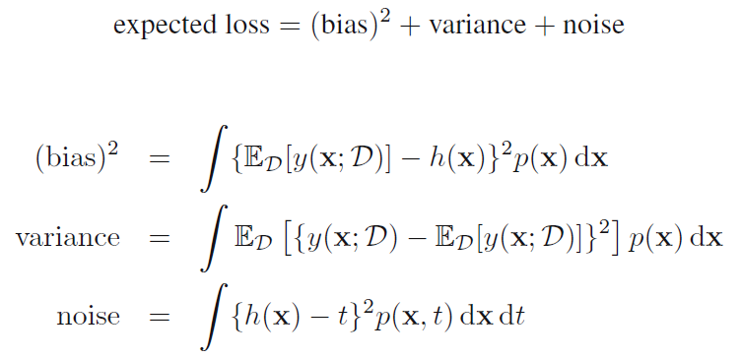
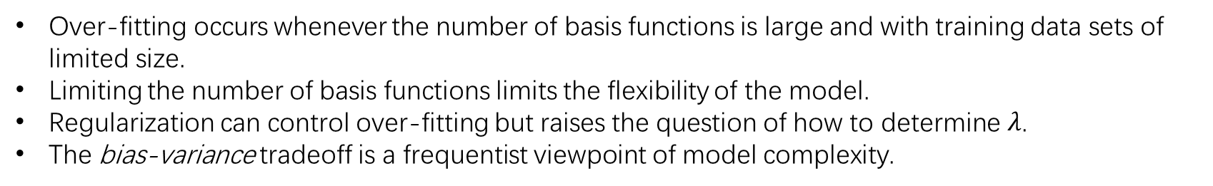
3.2. The Bias-Variance Decomposition
Over-fitting occurs whenever the number of basis functions is large and with training data sets of limited size.
Limiting the number of basis functions limits the flexibility of the model.
Regularization can control over-fitting but raises the question of how to determine $λ$.
The bias-variance tradeoff is a frequentist viewpoint of model complexity.
Conditional expectation
Expected squared loss
Notes:
this raises the question of how to determine a suitable value for the regularization coefficient λ. So we come to the topic of

Slide 8
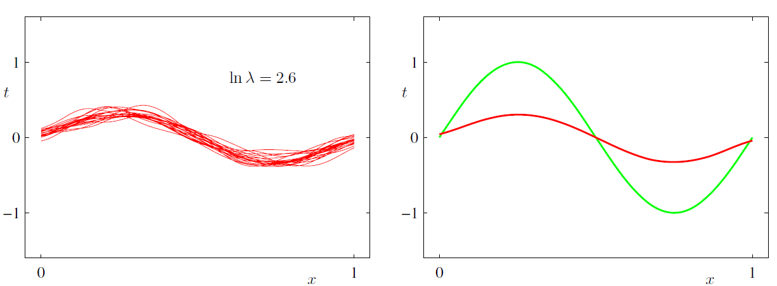
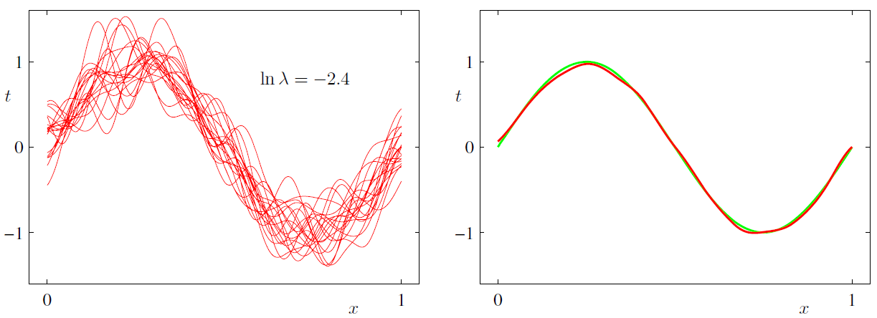
3.2. The Bias-Variance Decomposition
100 data sets
24 Gaussian basis functions
high bias and low variance
low bias and high variance

Slide 9
3.3. Bayesian Linear Regression
Maximum likelihood with a regularization term
Hard to decide the value of the regularization coefficient
Lead to excessively complex model
Over-fitting
Bayesian treatment of linear regression
avoid the over-fitting problem of maximum likelihood
lead to automatic methods of determining model complexity using the training data alone

Slide 10







3.3. Bayesian Linear Regression
Introduce a prior probability distribution over the model parameters w
Conjugate prior of the likelihood function
Then the posterior distribution
Sequential learning
Specifically, a zero-mean isotropic Gaussian governed by a single precision parameter $α$
Notes:
Maximization of this posterior distribution with respect to w is equivalent
to the minimization of the sum-of-squares error function with the addition of a
quadratic regularization term, corresponding to (3.27) with λ = α/β.

Slide 11
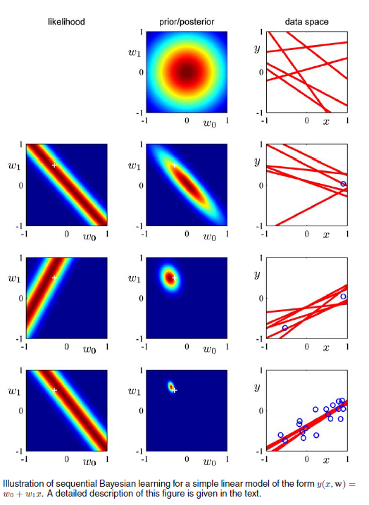


3.3. Bayesian Linear Regression
No observed data
A linear model
Generate data
a single data point
+Gaussian noise
Notes:
This is am example of sequential learning for a simple linear model.

Slide 12






3.3. Bayesian Linear Regression
Predictive distribution
conditional distribution
posterior weight distribution
noise on the data
uncertainty associated with the parameters w
Notes:
In practice, we are not usually interested in the value of w itself but rather in
making predictions of t for new values of x. This requires that we evaluate the
predictive distribution defined by

Slide 13
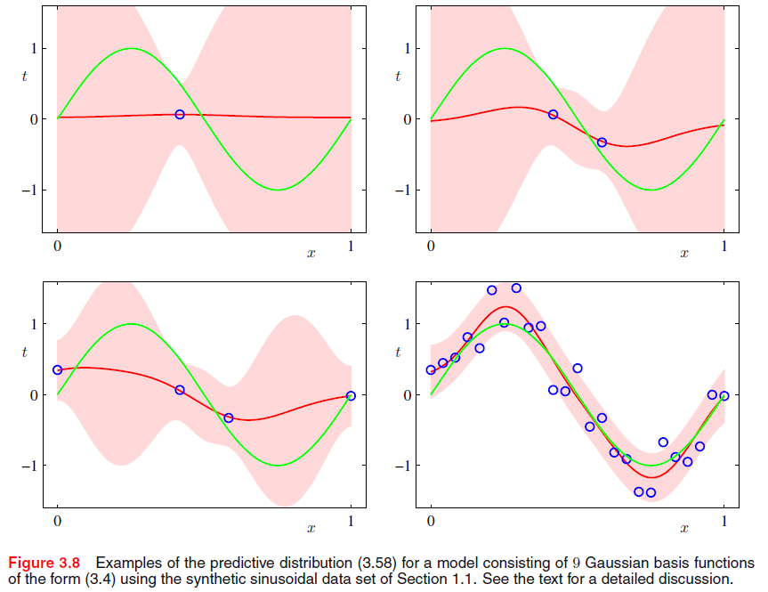
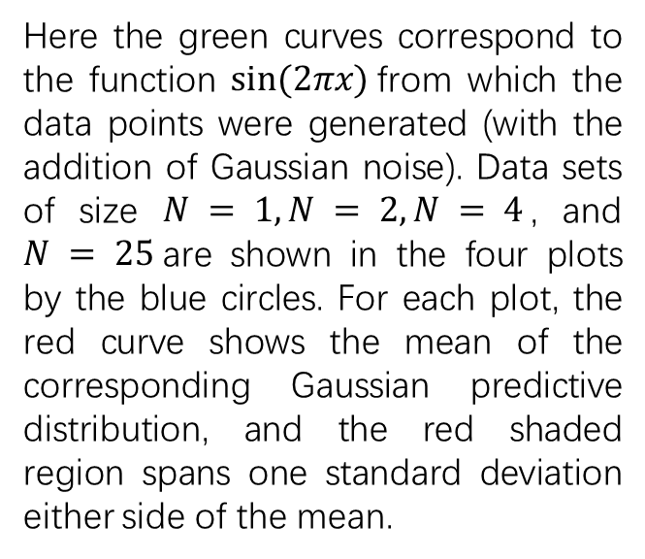
3.3. Bayesian Linear Regression
Predictive distribution
Here the green curves correspond to the function $sin⁡(2πx)$from which the data points were generated (with the addition of Gaussian noise). Data sets of size $N = 1, N = 2, N = 4$, and $N = 25$are shown in the four plots by the blue circles. For each plot, the red curve shows the mean of the corresponding Gaussian predictive distribution, and the red shaded region spans one standard deviation either side of the mean.
Notes:
This figure can only show the point-wise predictive variance as a function of x.

Slide 14
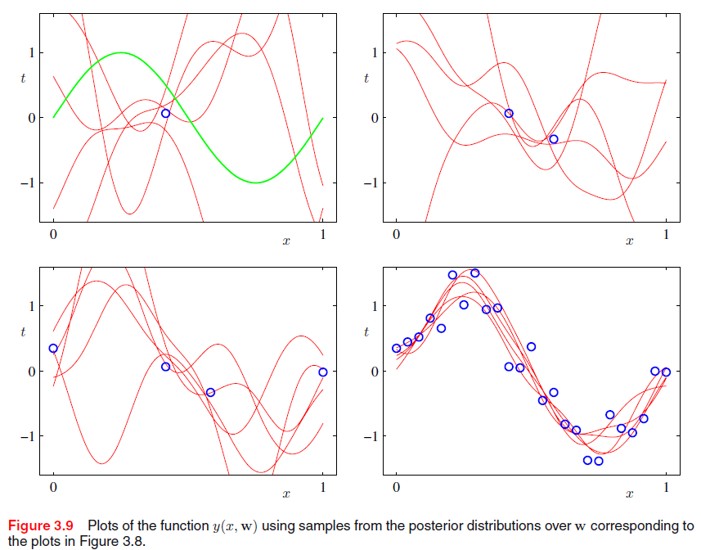
3.3. Bayesian Linear Regression
Predictive distribution
Notes:
In order to gain insight into the covariance between the predictions at
different values of x, we can draw samples from the posterior distribution over w,
and then plot the corresponding functions y(x,w)

Slide 15


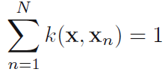

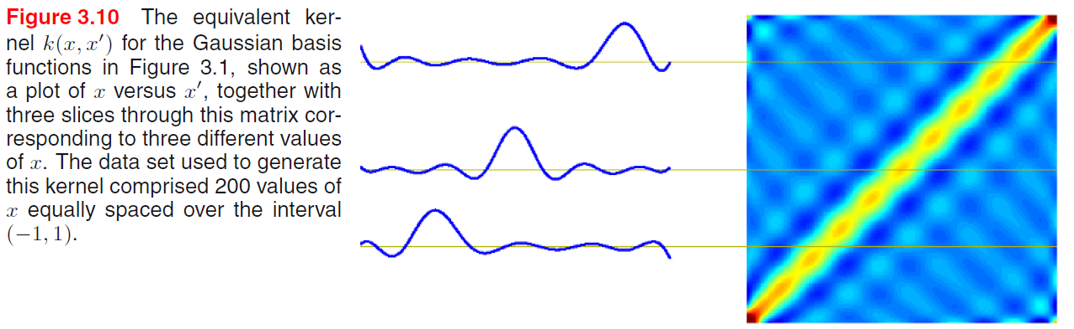
3.3. Bayesian Linear Regression
Equivalent kernel
The predictive mean can be written in the form
A linear combination of the training set target variables.
the smoother matrix or the equivalent kernel
make predictions by taking linear combinations of the training set target values
Notes:
The posterior mean solution (3.53) for the linear basis function model has an interesting interpretation that will set the stage for kernel methods

Slide 16



3.4. Bayesian Model Comparison
The overfitting that appears in maximum likelihood can be avoided by marginalizing over the model parameters.
All the data can be used for training the model;
We can compare models based on training data alone without a validation set.
posterior
model evidence or marginal likelihood
model evidence
Expected Bayes factor
Kullback-Leibler divergence
The correct model > The incorrect model

